Slide 1
GDP Growth and CO2 Emissions In The Developing World
Aaron Lopez

Slide 2
Dataset(s)
Which dataset did you use of the following:
World Development Indicators Dataset

Slide 3
Motivation
Describe the problem you want to solve with the data. It may relate closely with your research question, but your goal here is to make your audience care about the project/problem you are trying to solve. You need to articulate the problem you are exploring and why (and for whom) insight would be valuable.
CO2 emissions have been linked to global warming and climate change. The implications for the global economy, healthcare, geopolitics and future generations are tremendous. The fastest growing developing economies will have a more significant impact on policy development as their share of global growth increases. This will put those nations at the center for policy influence and decisions on how we deal with climate change.

Slide 4
Research Question(s)
What is your research question you aim to answer using the dataset? Be sure the research question is well defined (see project description for details).
Are CO2 emissions more correlated with rising GDP growth in developing countries than developed countries?
For the purpose of this question developing countries will be defined as Brazil, Russia, India, and China. These countries are often referred to as the “BRICs”. Developed countries are defined as the United States, Japan, Germany, and the United Kingdom.
Notes:
Add references to BRICs and method for developed countries definition.

Slide 5
Findings
<Feel free to replicate this slide to show multiple findings>
Present your findings. Include at least one visualization in your presentation (feel free to include more). The visualization should be honest, accessible, and elegant for a general audience.
You need not come to a definitive conclusion, but you need to say how your findings relate back to your research question.
In general, developing countries CO2 emissions seem to be highly correlated to rising GDP growth relative to developed countries which showed very low or negative correlation. The Russian Federation and Japan seemed to be the two outliers for both groups. This could be due to a number of factors including Japan being the only island nation and a lack of data for the Russian Federation prior to the collapse of the Soviet Union.

Slide 6
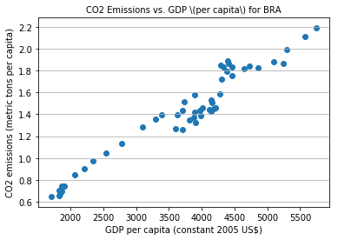
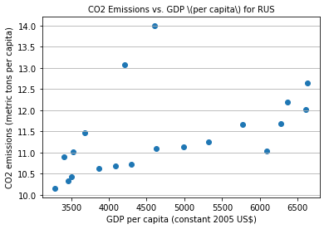
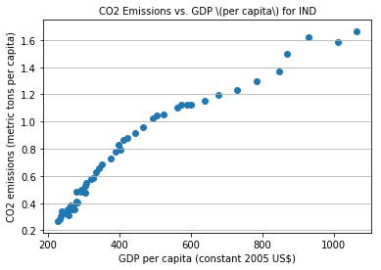
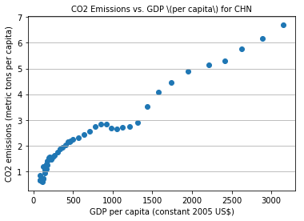
Country | Correlation
Brazil | 0.97
Russian Federation | 0.47
India | 0.96
China | 0.98

Slide 7
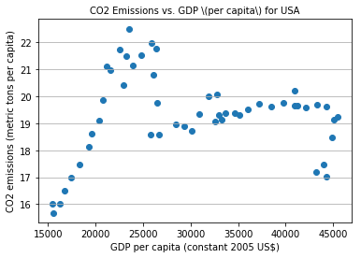
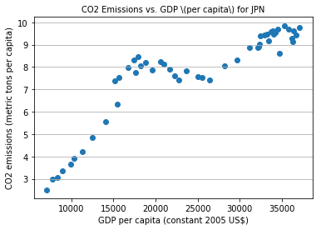
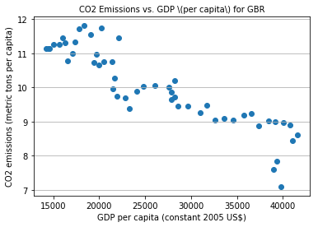
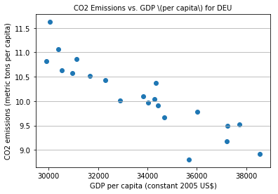
Country | Correlation
USA | 0.07
Japan | 0.88
United Kingdom | -0.90
Germany | -0.90

Slide 8
Acknowledgements
Did you use other informal analysis to inform your work? Did you get feedback on your work by friends or colleagues? Etc.
If you had no one give you feedback, it’s okay to say that.

Slide 9
References
If applicable, report any references you used in your work. For example, you may have used a research paper from X to help guide your analysis. You should cite that work here. If you did all the work on your own, please state this.

